Slide 1
Problem Statement The clinic has gotten several complaints regarding wait times. Task: Analysis, hypothesis, data story on overall wait time. Question from Management Why are we getting these complaints?  Do the hospital have staffing issues?  Are the complaints legitimate?  Is the hospital too busy?  Is it due to a certain type of patient?
HOSPITAL ANALYSIS

Slide 2
Insights Development
How to develop insights?
1. What are the business goals?
Make money/Limit long wait times
2. What is our metric of success or failure?
wait times
3. What are the trends? (positive or negative)
Times of the day when wait times increase
Days of week when wait times increase
4. How can we fix the trends?

Slide 3
Tools for Analysis
EXCEL
Pivot Tables
IF conditional
Conditional Formatting
Time conversions
New Dimensions
Functions: TEXT, DAYOFWEEK
Data Story (Beginning, Middle and End)
Power Point

Slide 4
Who is waiting the Longest
Financial Class
From the analysis, Financial Class does not significantly change the wait times. Although it seems Medicare takes the longest time to process. We do not have enough patients to conclude that this is a major factor.

Slide 5
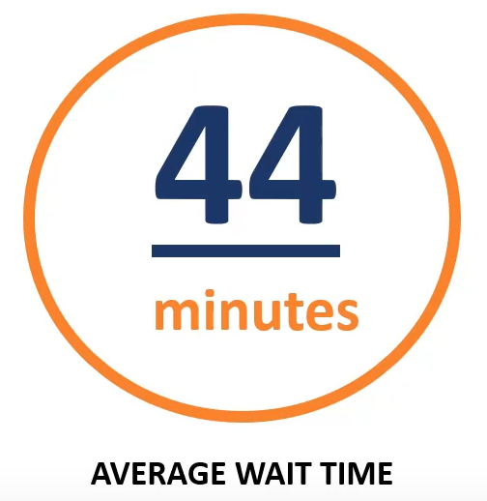
What Days of Week are Affected

Slide 6
Are Wait Times Associated with Busy Periods?
Lack of Staffing
From the existing data, it seems that staffing is sufficient. However, we may want to look at ensuring we have adequate staffing at the appropriate hours.

